Slide 2
Meta-information and Memory: How discriminability of meta-information about veracity affects memory
January 31, 2023
Lab Meeting
Work in Progress

Slide 3
Structure
Theoretical Background
Research question & Hypotheses
Results
Discussion
additional interesting findings
Odyssey of studies: more insights from previous studies
Future Direction
Notes:
- Andreea as inspiration

Slide 4
People are Truth-biased
Research shows that people are truth-biased as they remember more often false information as true than true information as false (Gilbert et al., 1993; Pantazi et al., 2018)
Spinozian Model (Gilbert et al., 1990)
Information is believed as true by default in a first processing stage
Tagging as false only happens in a second processing stage
additional cognitive effort to classify information as false
Truth bias also appears when information is clearly flagged as false (Thomas, 2016) and without cognitive load (Pantazi et al., 2020)
E.g.: labels, color highlighting, badges, trustworthy rating scales (Hamby et al., 2020)
Consequence:
False information affects memory, beliefs, judgments,…
Notes:
- Truth bias

Slide 5

Truth status as Source
Source: meta-information that is provided outside or inside the information body (Barzilai and Strømsø, 2018)
Truth status can be seen as a piece of meta-information
Recognizing and processing source helps to structure incoming information (Braasch & Kessler, 2021)
Requires enhanced cognitive effort, but people are reluctant to engage in sourcing strategies

Slide 6
Recognition Memory Vs. Source Memory
Recognition memory: discrimination between items that were presented (old) and items that were not (new) (Banks, 2000)
Source memory: discrimination between source A and source B (Banks, 2000)
information is often presented in different voices, font colors, highlighting
Truth-bias research: true/false information is also presented in different font colors (black/red) (Gilbert et al., 1993), different voices (male/female) (Pantazi et al., 2018)
clearly identifiable source features = easy accessible, low additional cognitive effort
Notes:
Item and source memory are mediated at least in part by different processes during encoding
Traditionally additional source is seen as enhancing memory about information – contextual information

Slide 7
Research Question & Hypotheses
How does the presence of meta-information about veracity affect mental representations when it is easy or hard to distinguish?
→ increased cognitive effort for meta-information processing
Study 1 - Recognition Memory:
Interaction effect between veracity and discriminability: Recognition memory will be higher for true than false statements when a discriminability task is present.
Study 2 - Source Memory:
Interaction effect between veracity and discriminability (and classification):
Participants in the reduced cognitive effort (high discriminability) condition will more often classify statements correctly as true or false than in the enhanced cognitive effort (low discriminability) condition.

Slide 8



Study Setting
Setting: Participants read one scene description (40 sentences)
true (30 sentences) and false (10 sentences) sentences presented in different font colors → veracity is randomly assigned
Afterward:
Recognition Memory: “Did you read this statement?” [Study 1]
→ veracity status is not relevant
Source Memory: “Was this statement true, false, or new?” [Study 2]
Dependent variable:
Recognition Memory: correct answers
Source Memory: answer based on classification into correct, confounded, misidentified
Correct: true sentence classified as true
Confounded: true sentence classified as false or vice versa
Misidentified: read statements as new or vice versa

Slide 9
Example Study material:
Base
Low
High

Slide 10
Research Question & Hypotheses
How does the presence of meta-information about veracity affect mental representations when it is easy or hard to distinguish?
→ increased cognitive effort for meta-information processing
Study 1 - Recognition Memory:
Interaction effect between veracity and discriminability: Recognition memory will be higher for true than false statements when a discriminability task is present.
Study 2 - Source Memory:
Interaction effect between veracity and discriminability (and classification):
Participants in the reduced cognitive effort (high discriminability) condition will more often classify statements correctly as true or false than in the enhanced cognitive effort (low discriminability) condition.

Slide 11
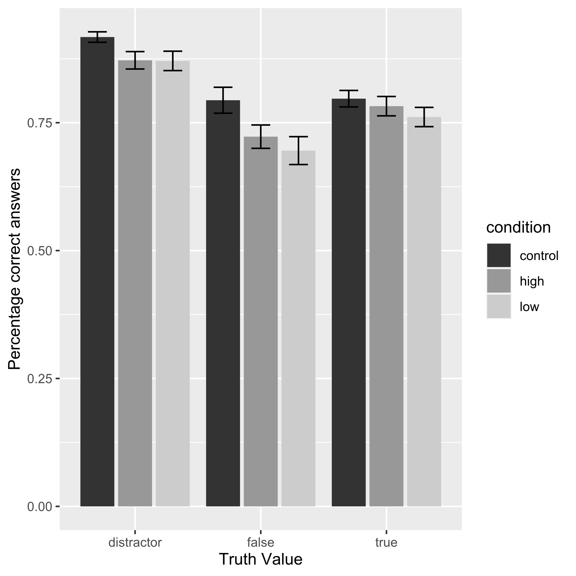
Results Study 1:
significant interaction effect between the truthfulness of sentences and condition, χ²(1) = 7.68, p = .021
In the two discriminability conditions, true sentences were remembered better than false sentences (low: t(65) = -2.34, p = .022; high: t(65) = -2.29, p = .025)
Figure 1. Mean correct answers for the statements per truth value and condition. Error bars represent standard error. N = 198
Notes:
Memory performance high
no difference in memory performance in the control condition between true and false sentences, t(65) = -0.16, p = .877
Overall memory performance between the conditions did not differ, χ²(2) = 5.42, p = .07.

Slide 12
Hypothesis
Study 1 - Recognition Memory:
Interaction effect between veracity and discriminability: Recognition memory will be higher for true than false statements when a discriminability task is present.
Better memory for true than for false sentences in low and high discriminability conditions
No difference in memory performance between the two discriminability conditions

Slide 13
Research Question & Hypotheses
How does the presence of meta-information about veracity affect mental representations when it is easy or hard to distinguish?
→ increased cognitive effort for meta-information processing
Study 1 - Recognition Memory:
Interaction effect between veracity and discriminability: Recognition memory will be higher for true than false statements when a discriminability task is present.
Study 2 - Source Memory:
Interaction effect between veracity and discriminability (and classification):
Participants in the reduced cognitive effort (high discriminability) condition will more often classify statements correctly as true or false than in the enhanced cognitive effort (low discriminability) condition.

Slide 14
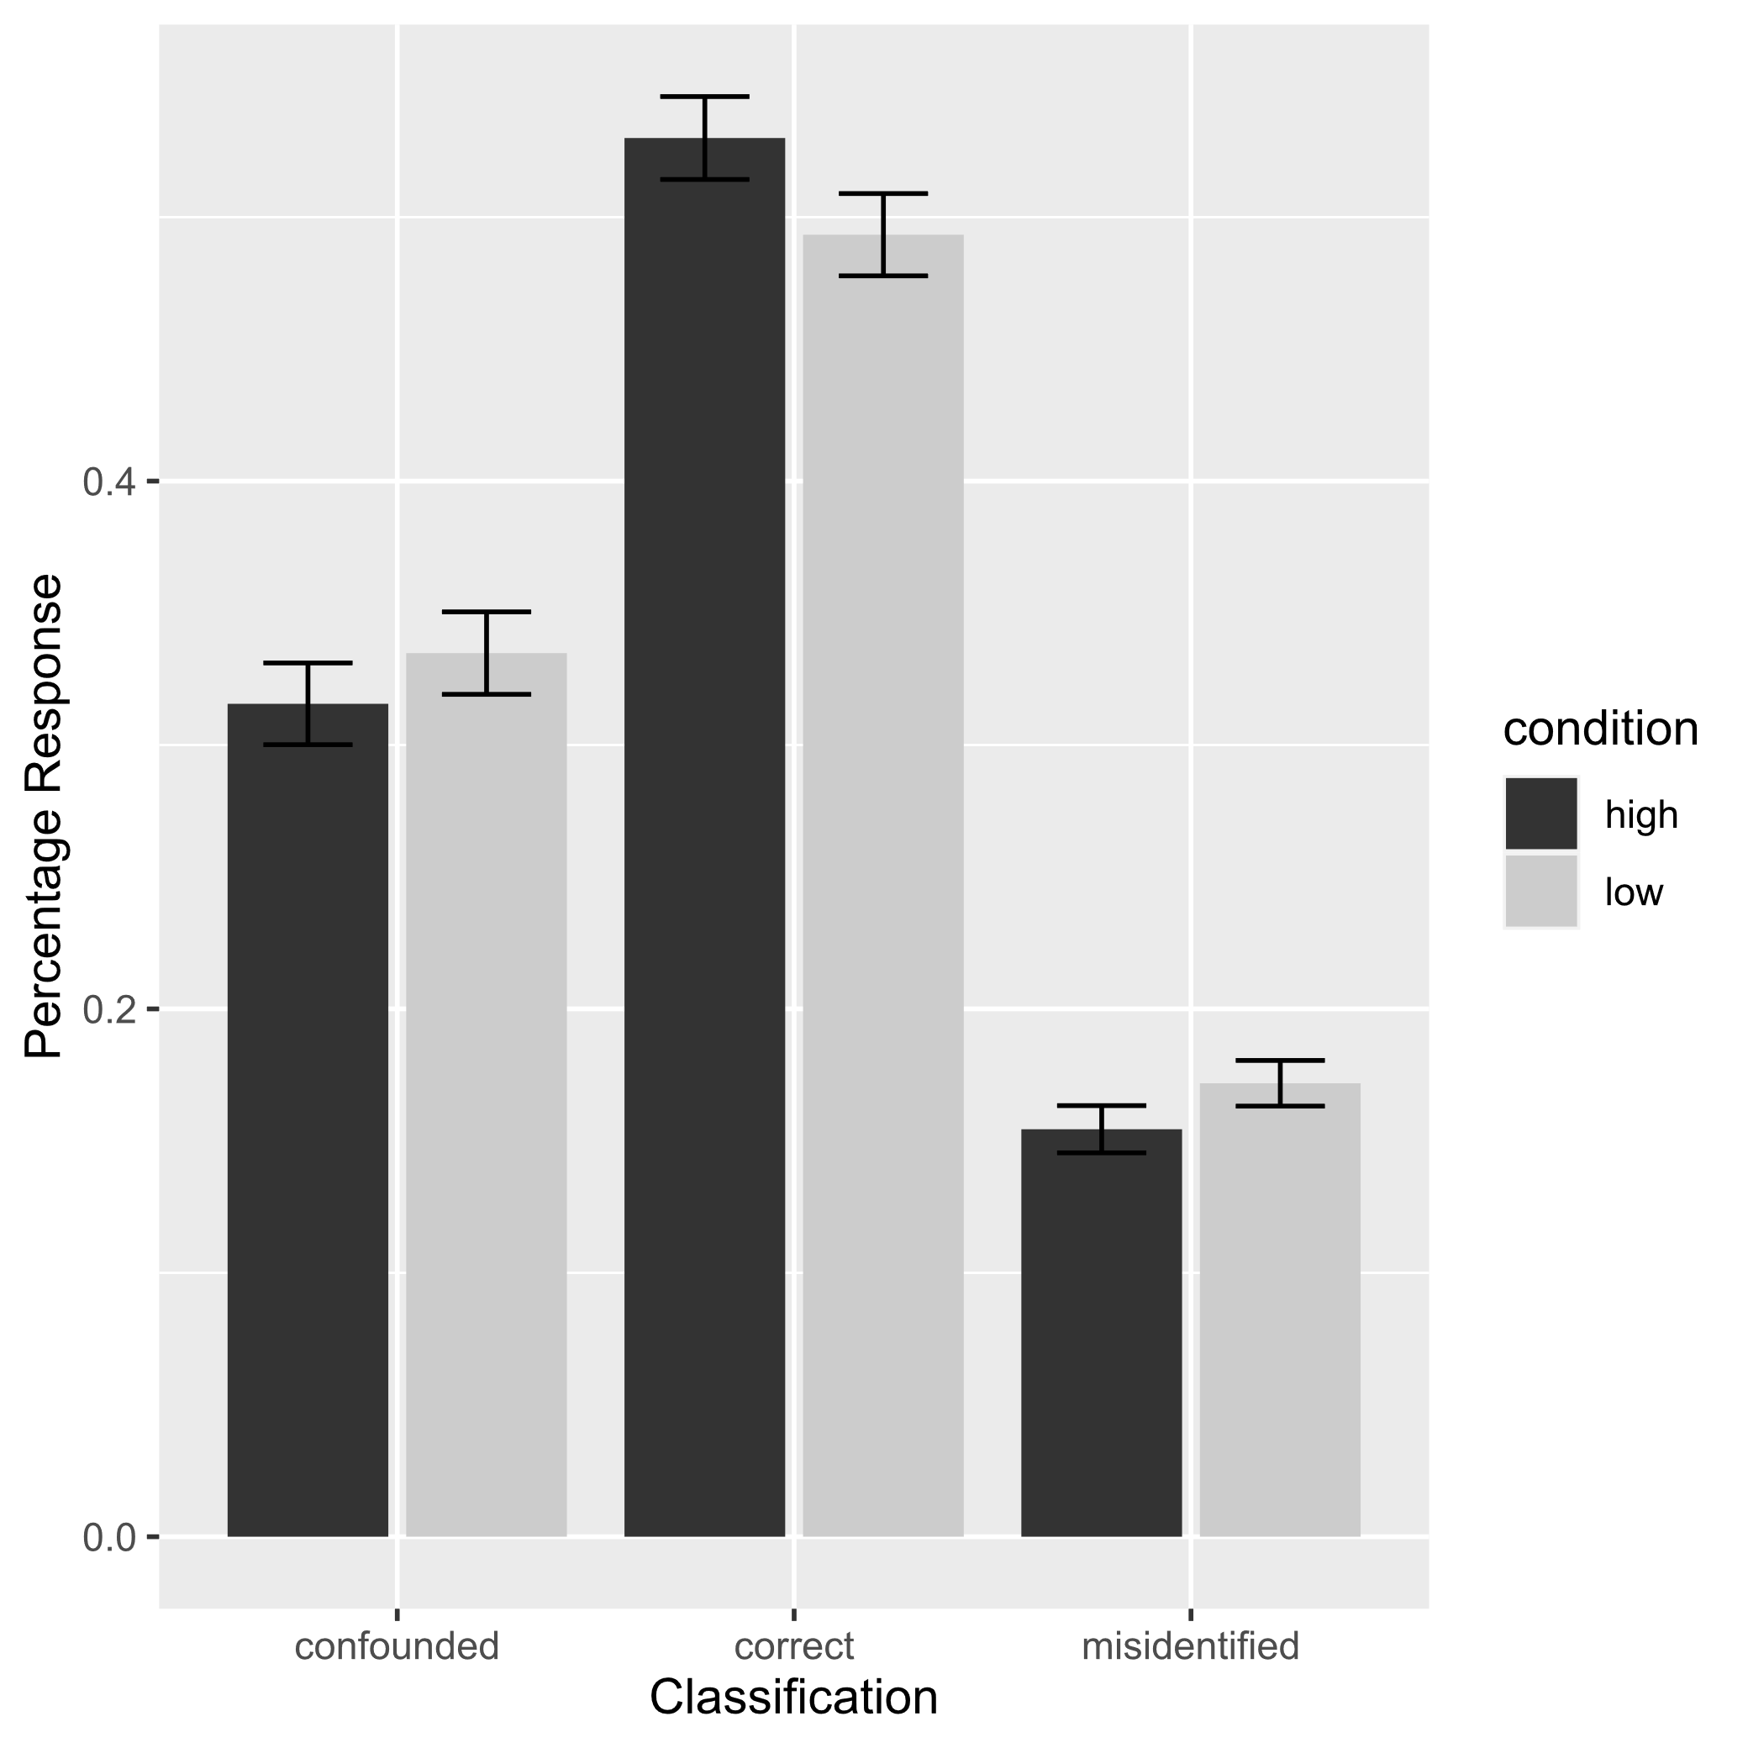
Results Study 2:
No three-time interaction between classification, condition, and veracity, χ²(2) = 2.15, p = .341
significant interaction effect between classification and condition, χ²(2) = 20.27, p < .001
Figure 2. Mean response for the statements per classification and condition. Error bars represent standard error. N = 248
Notes:
No three-time interaction between classification, condition, and veracity, χ²(2) = 2.15, p = .341

Slide 15
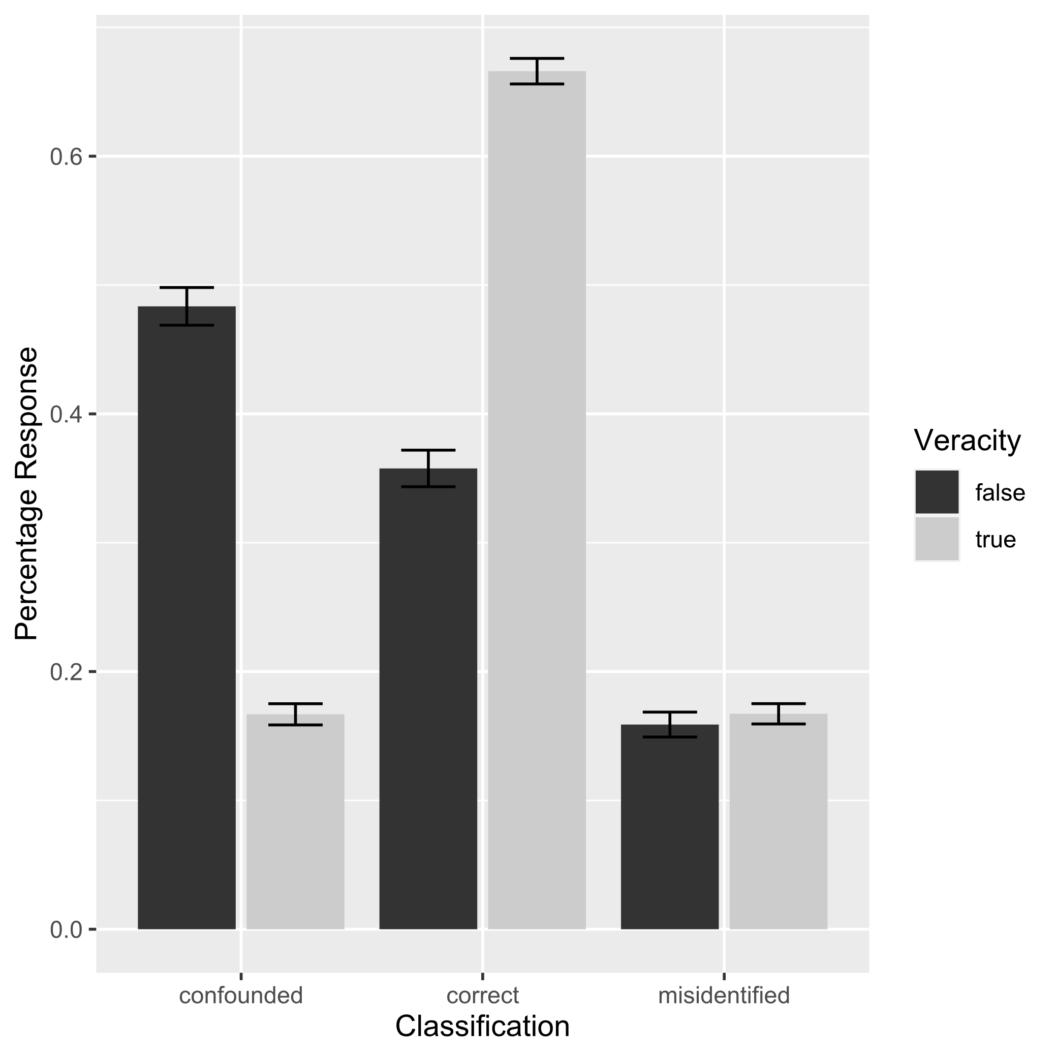
Results Study 2:
No three-time interaction between classification, condition, and veracity, χ²(2) = 2.15, p = .341
significant interaction effect between classification and condition, χ²(2) = 20.27, p < .001
significant interaction effect between veracity and classification, χ²(2) = 1612.97, p < .001
Figure 3. Mean response for the statements per truth value and classification. Error bars represent standard error. N = 248
Notes:
No three-time interaction between classification, condition, and veracity, χ²(2) = 2.15, p = .341

Slide 16
Hypotheses
Study 1 - Recognition Memory:
Interaction effect between veracity and discriminability: Recognition memory will be higher for true than false statements when a discriminability task is present.
Better memory for true than for false sentences in low and high discriminability conditions
No difference in memory performance between the two discriminability conditions
Study 2 - Source Memory:
Interaction effect between veracity and discriminability (and classification):
Participants in the reduced cognitive effort (high discriminability) condition will more often classify statements correctly as true or false than in the enhanced cognitive effort (low discriminability) condition.
False sentences overall less often correctly classified and more often confounded
Increased cognitive effort resulted in less correct classified sentences – but that was independent of the veracity of the sentences

Slide 17
Discussion
Cognitive effort
Increased cognitive effort influences correct classification independent of additional veracity discrimination
more challenging to remember the correct source
Results are in favor of the truth bias – better memory for true than for false information, and false sentences confounded
Even present without additional distractor task and immediate recollection task

Slide 18
Discussion & Limitation
Influence of instruction?
Difficult to differentiate between correctly representing and memorizing all information → participants might have seen false information as irrelevant information
Using color as a cue: reduced cognitive load → reduced memory due to different processing of information
able to “skip” irrelevant information during self-paced reading task
no additional uncertainty option → alternative processing Cartesian Model (Nadarevic et al., 2019) or Dual-Recollection Theory (Brainerd et al., 2014)
visual difference between presentation and test
Factual vs. fictional story – both activate processes of imagination, but different simulations (Altmann et al., 2014)
Notes:
Cartesian model: true and false are stored with tags, while spinozan model stores only false information with additional tag
Dual-recollection theory: comprehension approach: distinction between conscious reinstatement of contextual information and the conscious reinstatement of target events per
- two distinct processing that lead to distinct episodic representations: ground/part information and figure/whole information → target stimulus is a whole/figure information, whereas contextual details are ground/part information
Richter et al. (2009) People use knowledge in a fast and nonstrategic way – this validation process of incoming information is a companion of comprehension

Slide 19
Further Interesting Findings
Confidence
Reading Time
“Recognition Memory” in Study 2

Slide 20
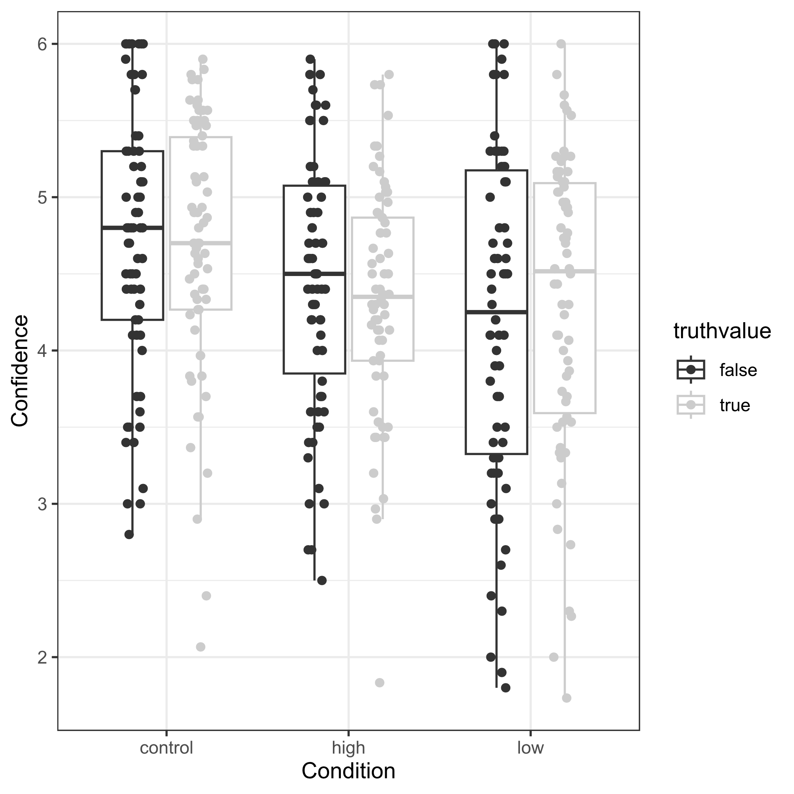
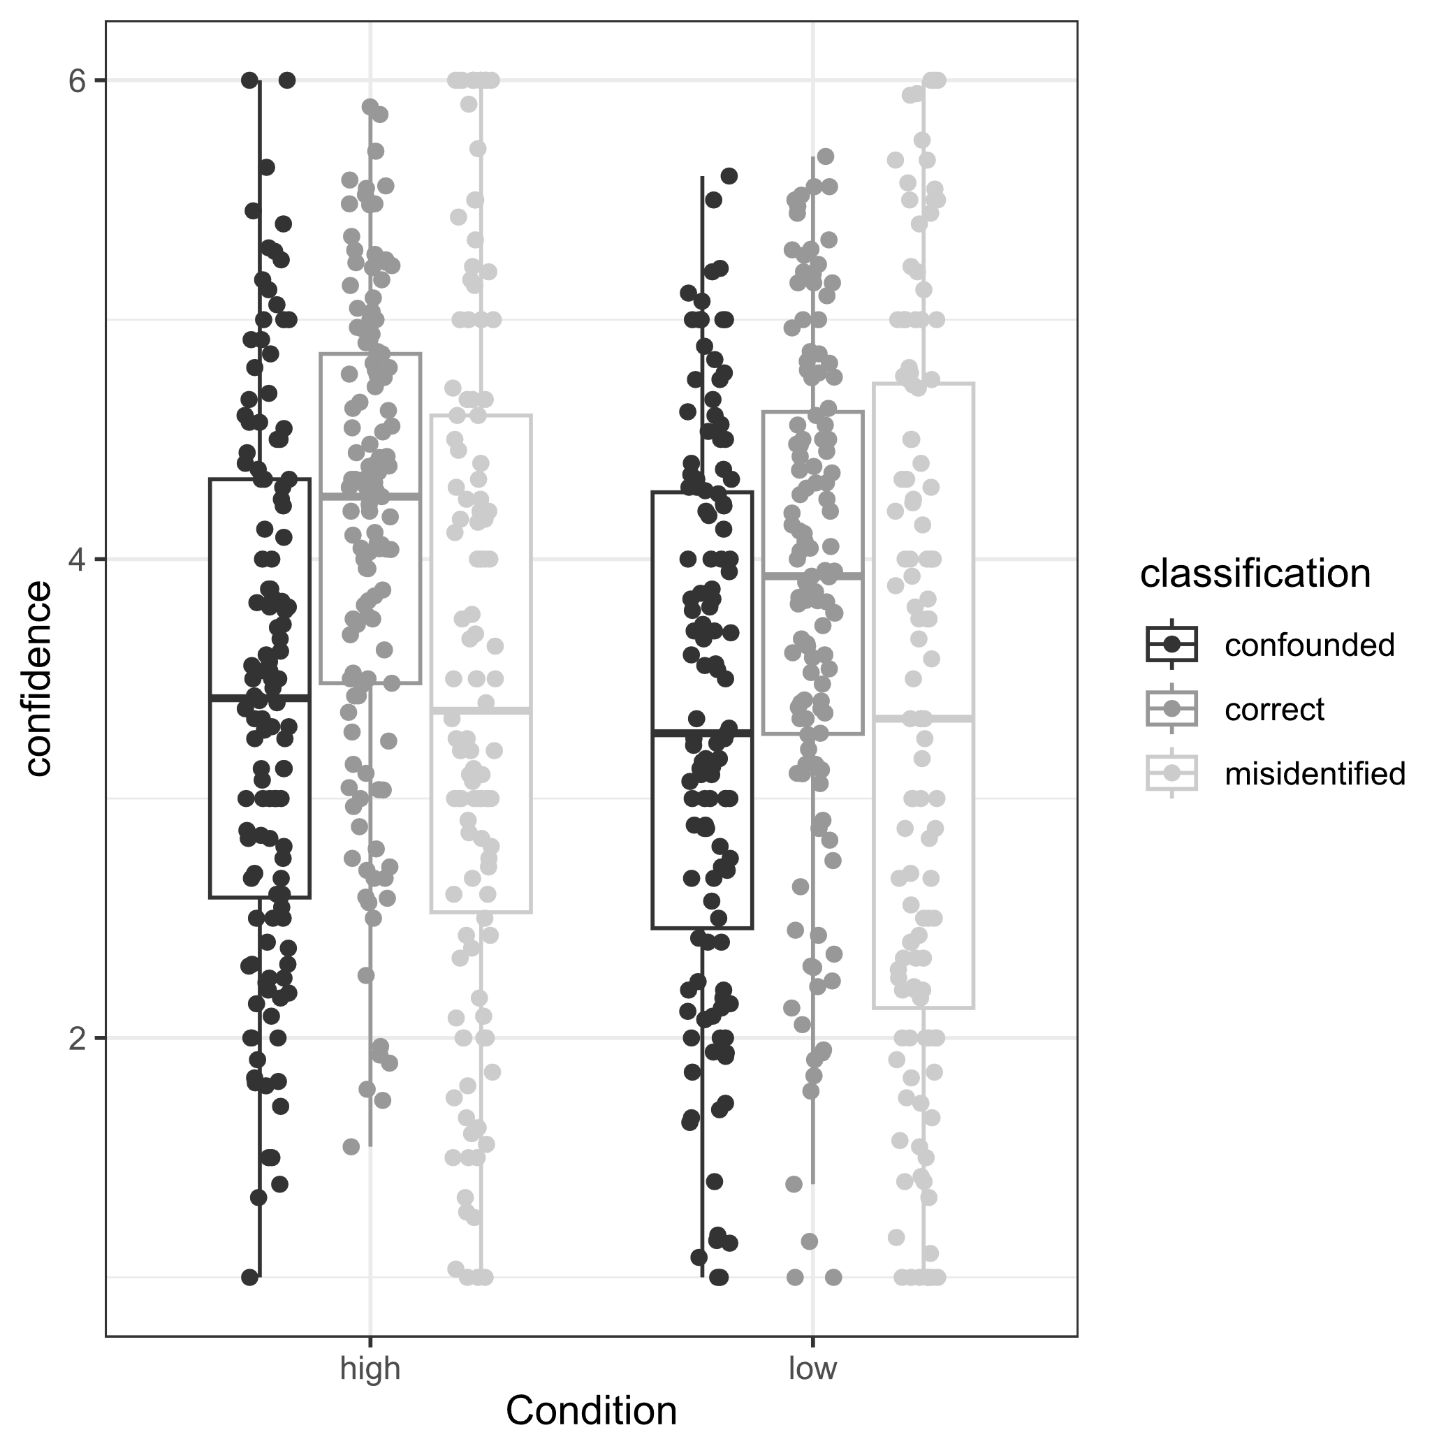
Confidence
Study 1:
Study 2:
Figure 4. Mean confidence per truth value and condition. N = 198
Figure 5. Mean confidence for classification and condition. N = 248

Slide 21
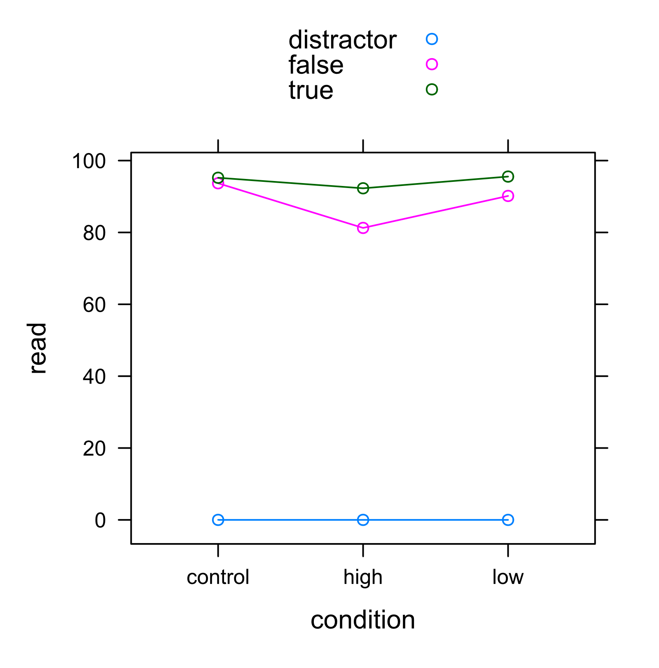
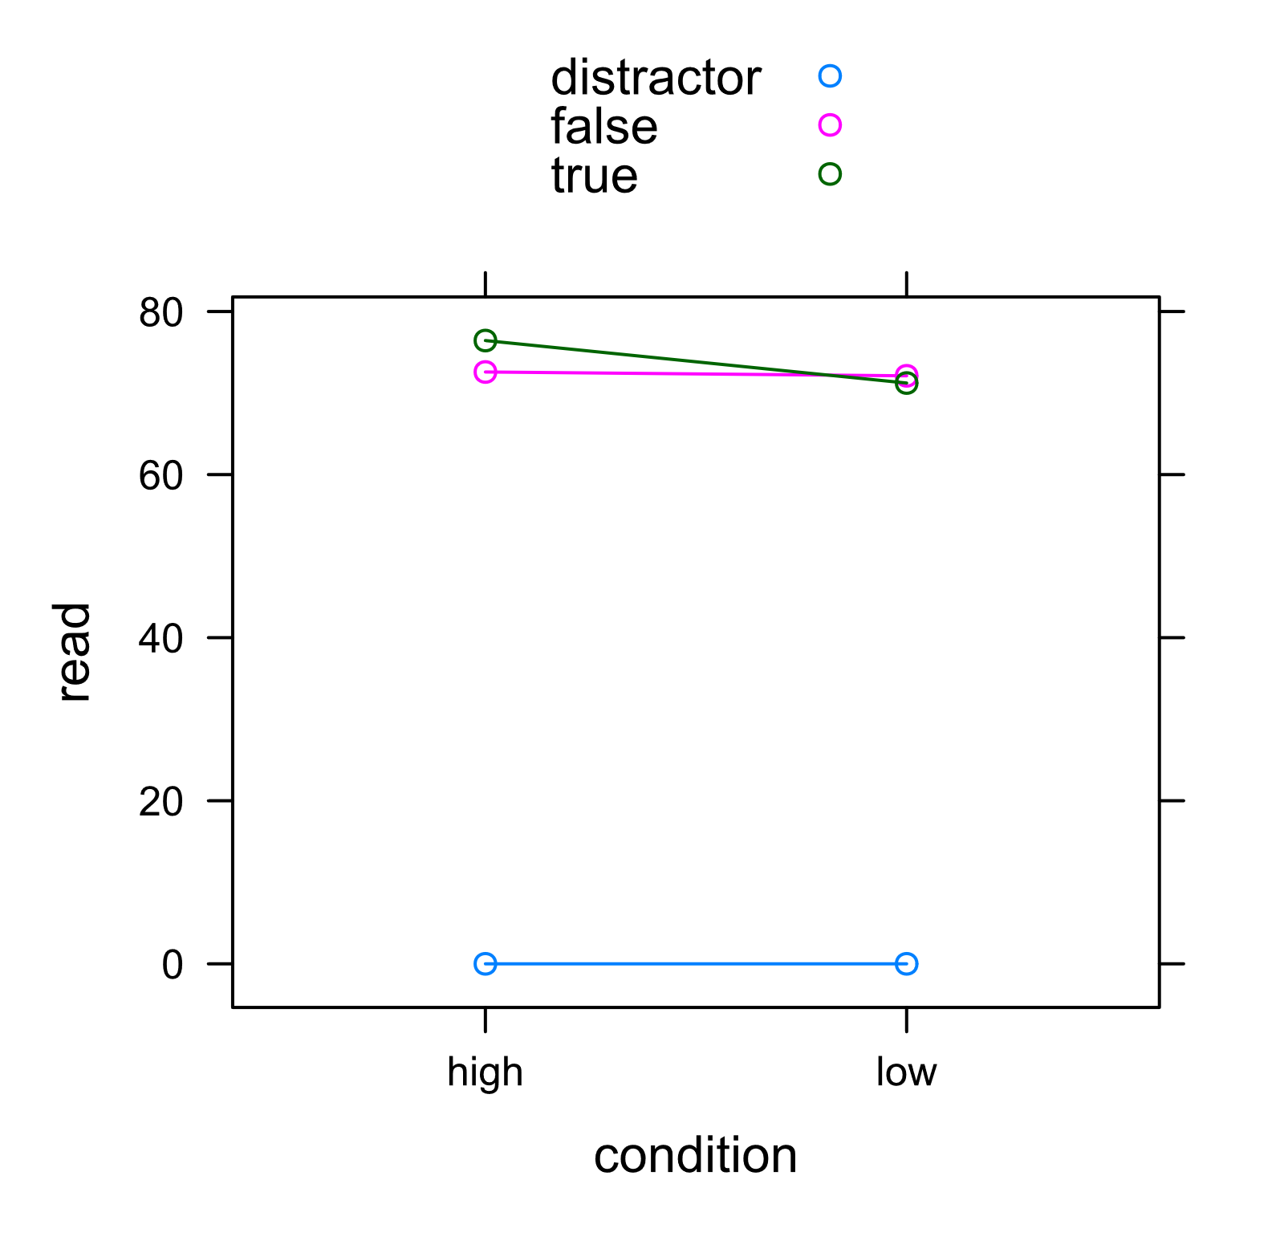
Reading Time
Study 1:
Study 2:
Figure 6. Mean reading time per letter for the statements per truth value and condition. N = 198
Figure 7. Mean reading time per letter for the statements per truth value and condition. N = 248
no significant differences
Significant interaction effect between condition and veracity

Slide 22
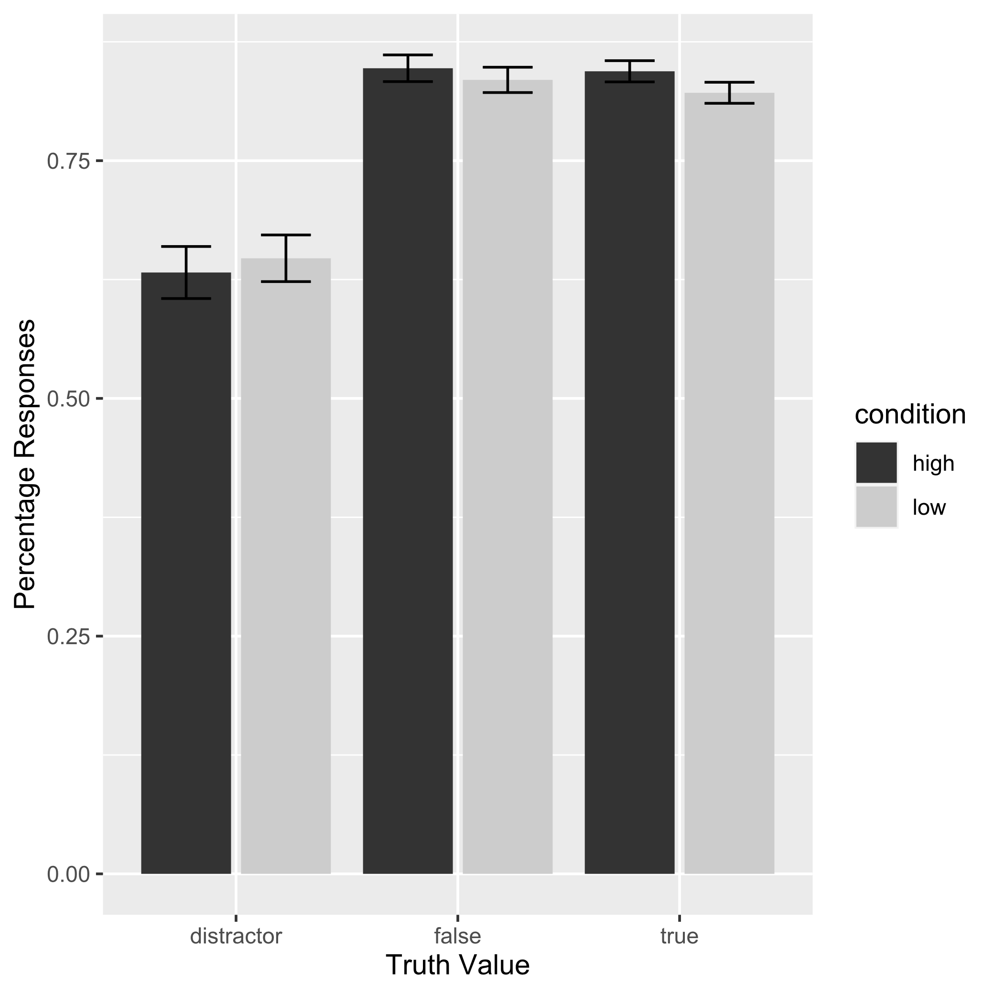
“Recognition Memory” in Study 2
High recognition memory for true and false statements based on true/false answers independent of correctness
Low correct classification for distractor items
Context reinstatement boosts memory but also increases the likelihood of confusion (Doss et al., 2018)
Figure 8. Mean response transferred to recognition memory per truth value and condition. N = 248

Slide 23
Odyssey of Studies
1st Study:
true information was remembered better than false information, but also in the control condition, which had no information about the truth content
2nd Study:
False information less relevant for understanding the story
3rd Study:
Higher recall with a structured presentation of sentences

Slide 24
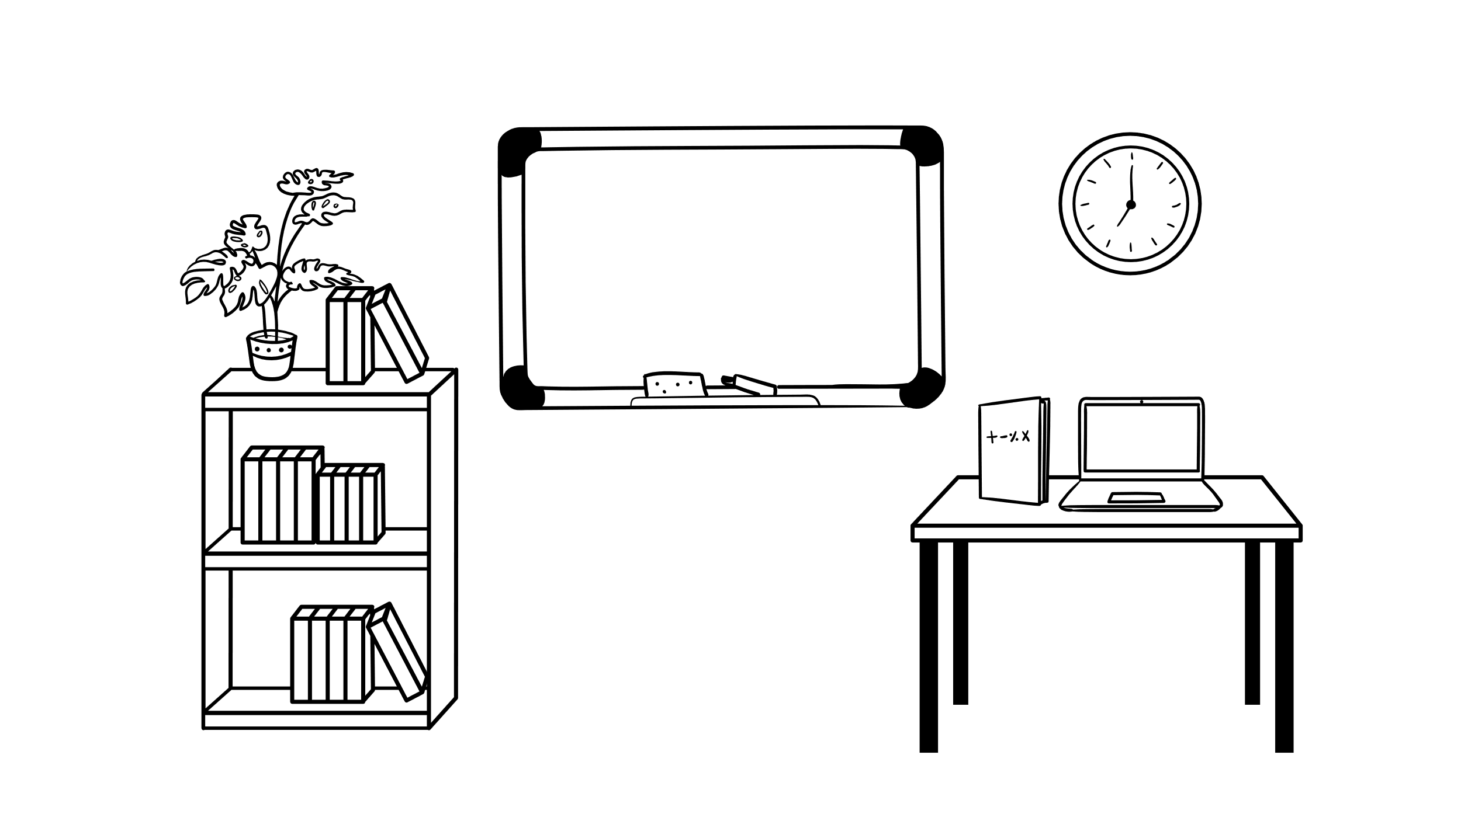
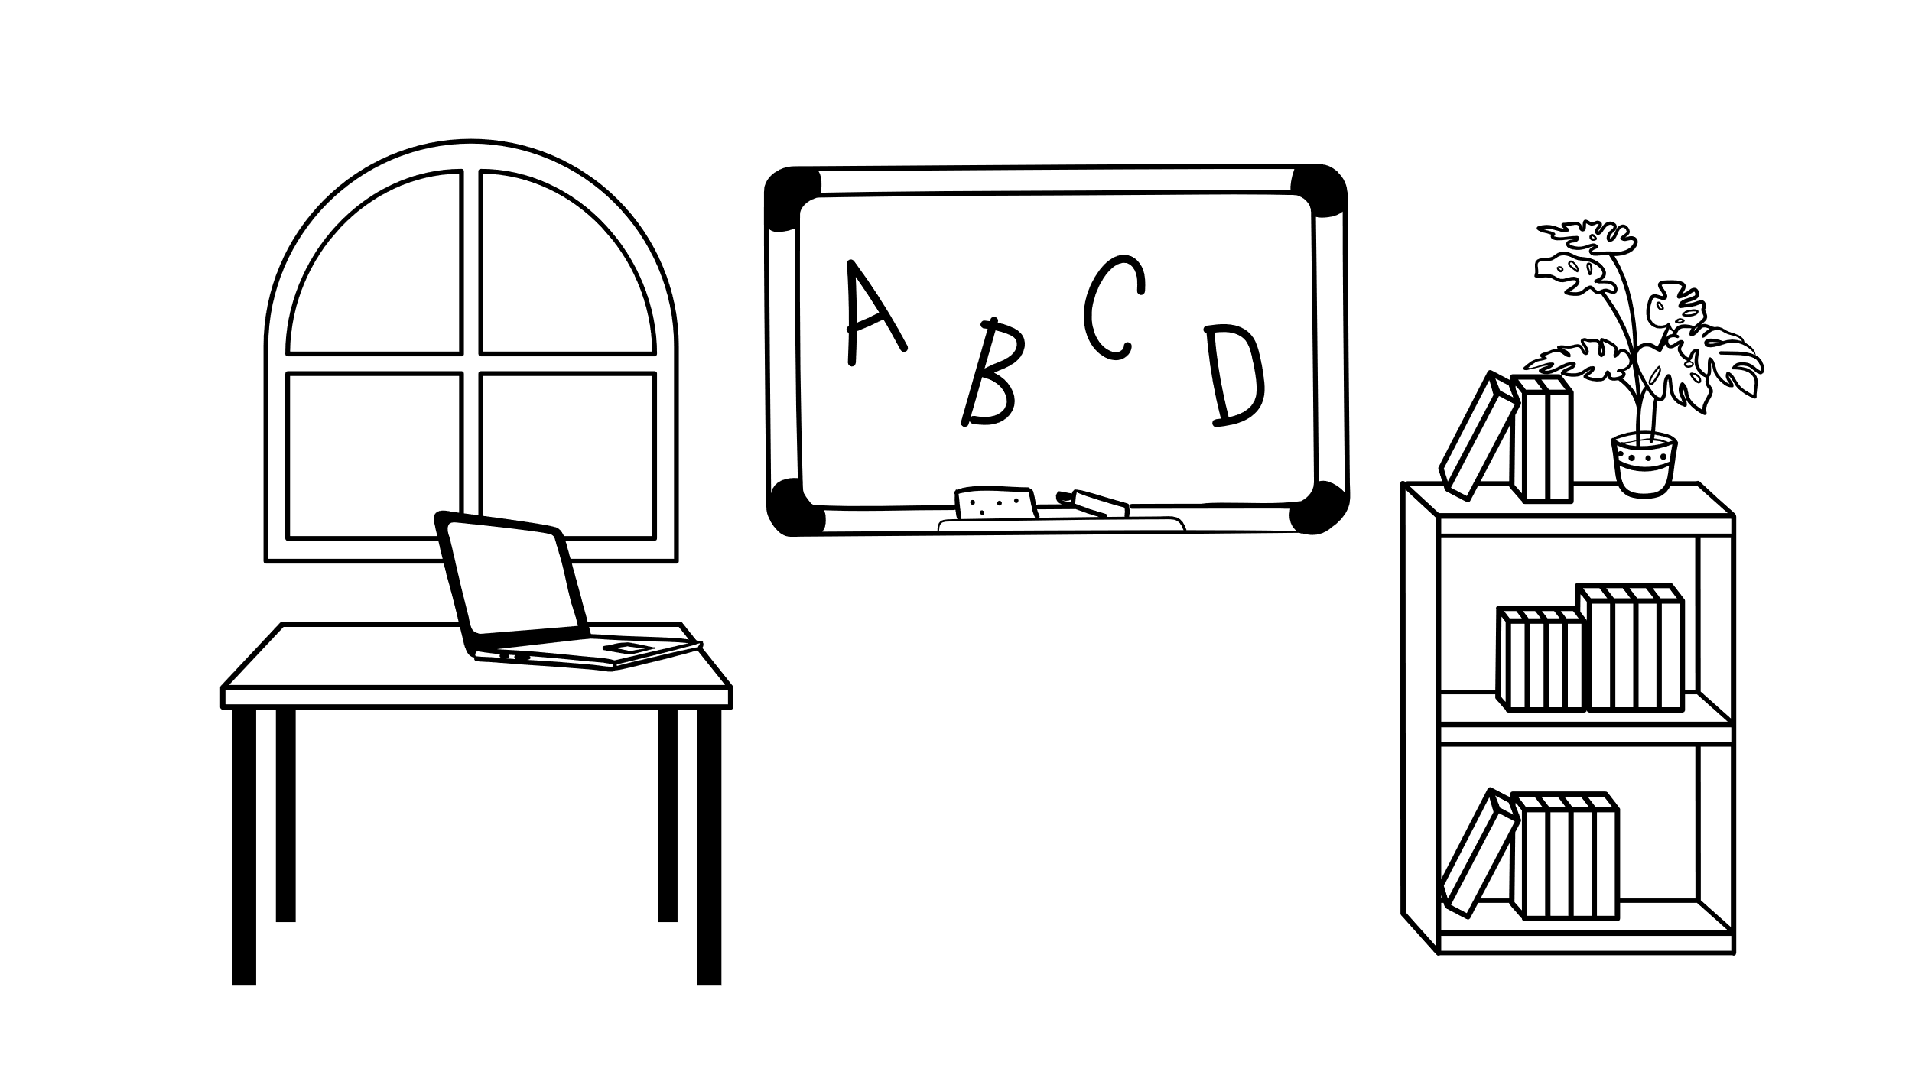

Future Direction
more in the direction of scene understanding
Taken data from previous studies: one story does not show the pattern of low memory for false sentences in the control condition
→ usable for inference study
→ local inferences

Slide 25


Thank you for your Attention
Any questions, recommendations, or commands?

Slide 26
Sources
Busselle, R., & Bilandzic, H. (2009). Measuring narrative engagement. Media psychology, 12(4), 321–347.
Clayton, K., Blair, S., Busam, J. A., Forstner, S., Glance, J., Green, G., Kawata, A., Kovvuri, A., Martin, J., Morgan, E., & others. (2020). Real solutions for fake news? Measuring the effectiveness of general warnings and fact-check tags in reducing belief in false stories on social media. Political Behavior, 42(4), 1073–1095.
Gilbert, D. T., Tafarodi, R. W., & Malone, P. S. (1993). You can’t not believe everything you read. Journal of personality and social psychology, 65(2), 221.
Graesser, A. C., Louwerse, M. M., McNamara, D. S., Olney, A., Cai, Z., & Mitchell, H. H. (2007). Inference generation and cohesion in the construction of situation models: Some connections with computational linguistics. Higher level language processes in the brain: Inference and comprehension processes, 289–310.
Hamby, A., Ecker, U., & Brinberg, D. (2020). How stories in memory perpetuate the continued influence of false information. Journal of Consumer Psychology, 30(2), 240–259.
Lewandowsky, S., Ecker, U. K., Seifert, C. M., Schwarz, N., & Cook, J. (2012). Misinformation and its correction: Continued influence and successful debiasing. Psychological science in the public interest, 13(3), 106–131.
Nadarevic, L., & Erdfelder, E. (2019). More evidence against the Spinozan model: Cognitive load diminishes memory for “true” feedback. Memory & Cognition, 47(7), 1386–1400.
Pantazi, M., Kissine, M., & Klein, O. (2018). The power of the truth bias: False information affects memory and judgment even in the absence of distraction. Social cognition, 36(2), 167–198.
Pennycook, G., & Rand, D. G. (2020). Who falls for fake news? The roles of bullshit receptivity, overclaiming, familiarity, and analytic thinking. Journal of personality, 88(2), 185–200.
Unkelbach, C. (2007). Reversing the truth effect: Learning the interpretation of processing fluency in judgments of truth. Journal of Experimental Psychology: Learning, Memory, and Cognition, 33(1), 219.
Yeshurun, Y., Swanson, S., Simony, E., Chen, J., Lazaridi, C., Honey, C. J., & Hasson, U. (2017). Same story, different story: The neural representation of interpretive frameworks. Psychological science, 28(3), 307–319.
Zacks, J. M. (2020). Event Perception and Memory. Annual Review of Psychology, 71(1), 165–191. https://doi.org/10.1146/annurev-psych-010419-051101

